Slide 1
Python Review
Aka. Python in 5 minutes
By Dr. Dongchul Kim

Slide 2
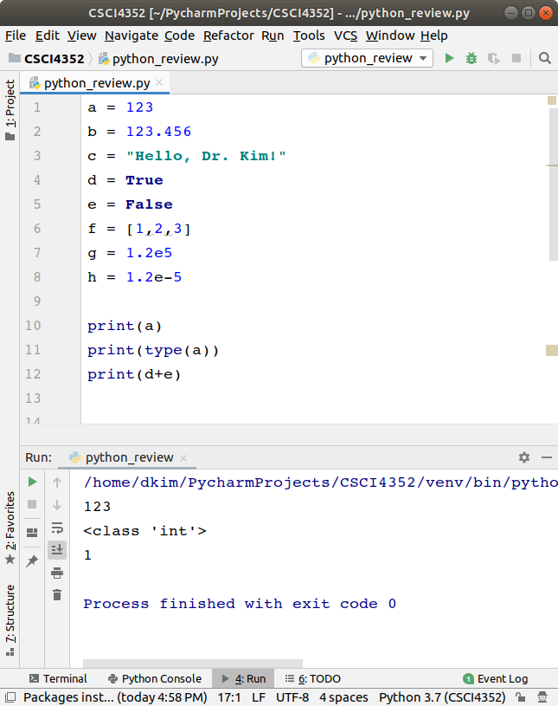
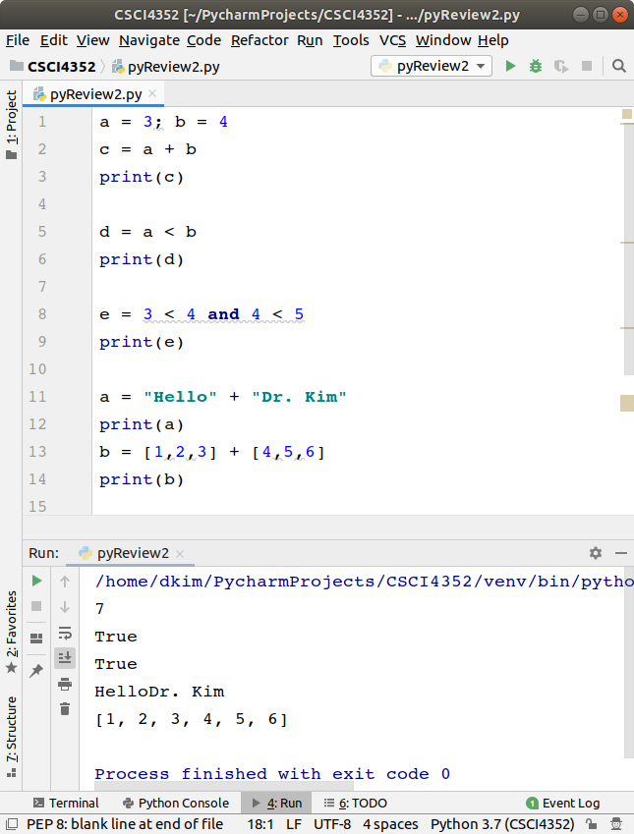
Variable and Operators

Slide 3
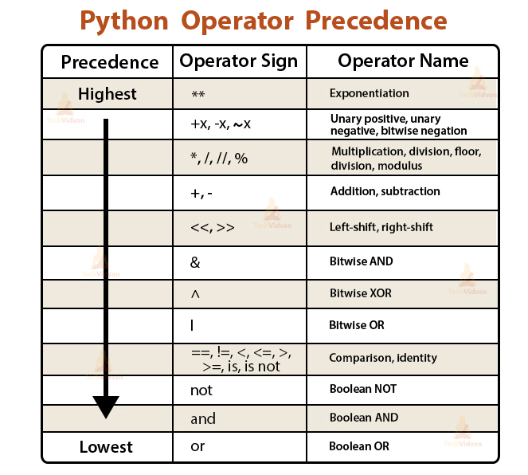

Slide 4
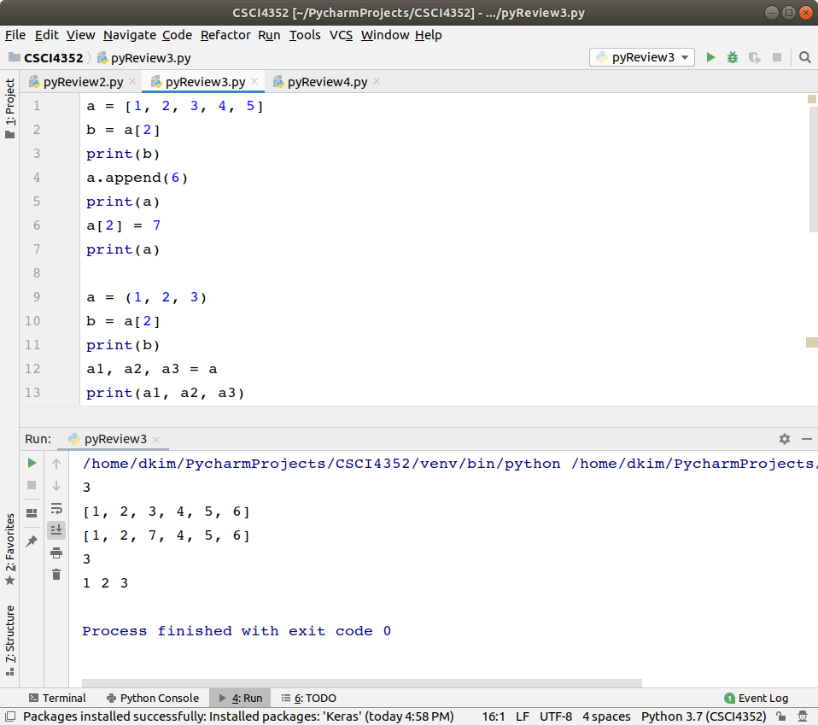
List and Tuple

Slide 5
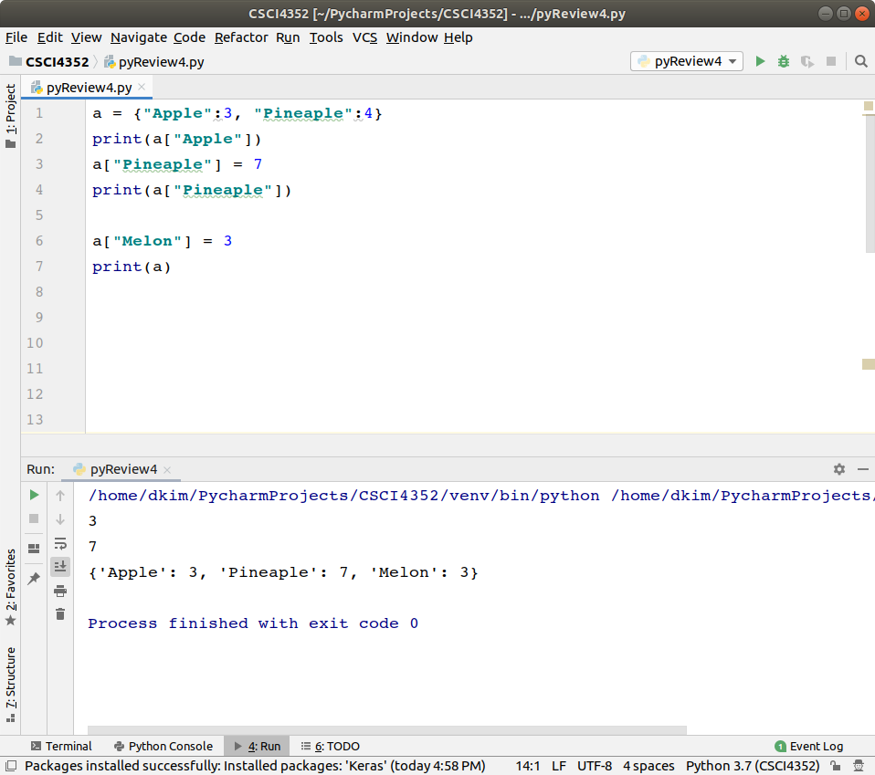
Dictionary

Slide 6
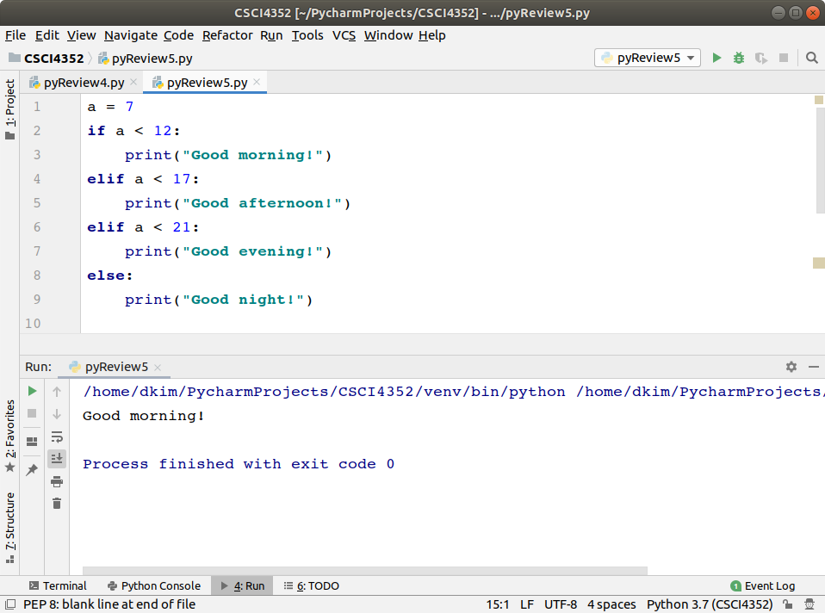
if

Slide 7
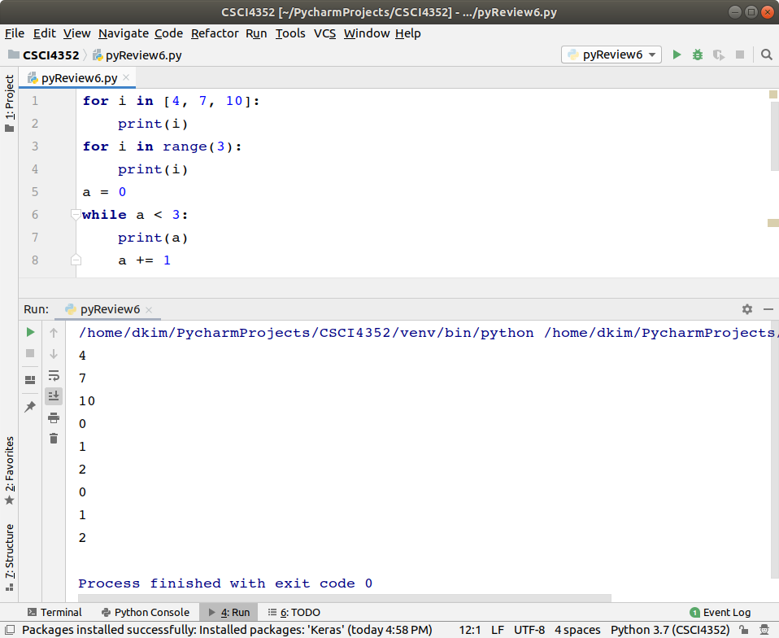
Loop

Slide 8
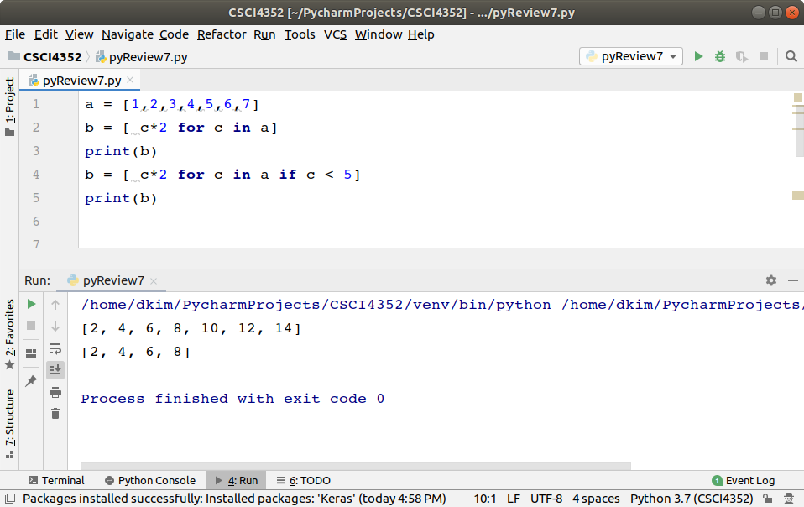
Comprehension

Slide 9
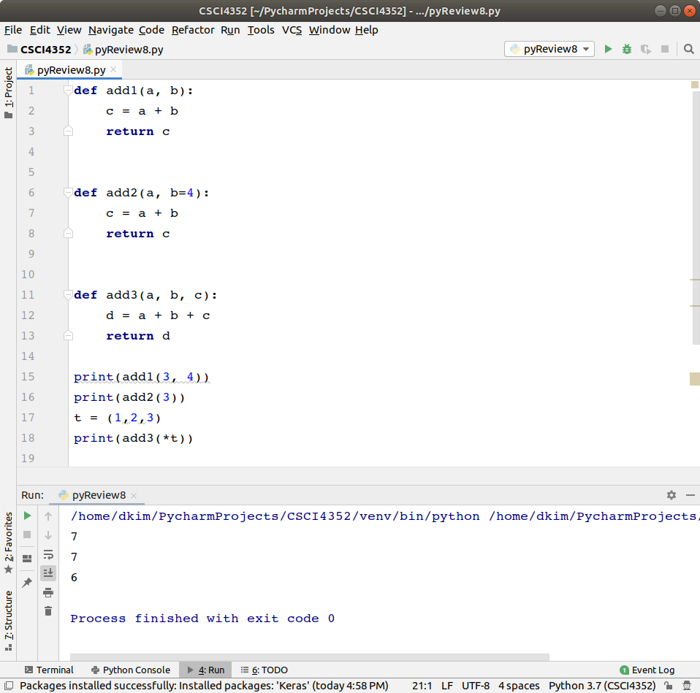
Function

Slide 10
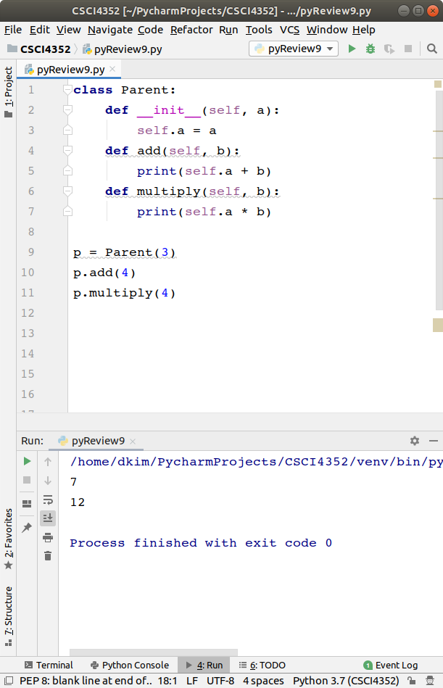
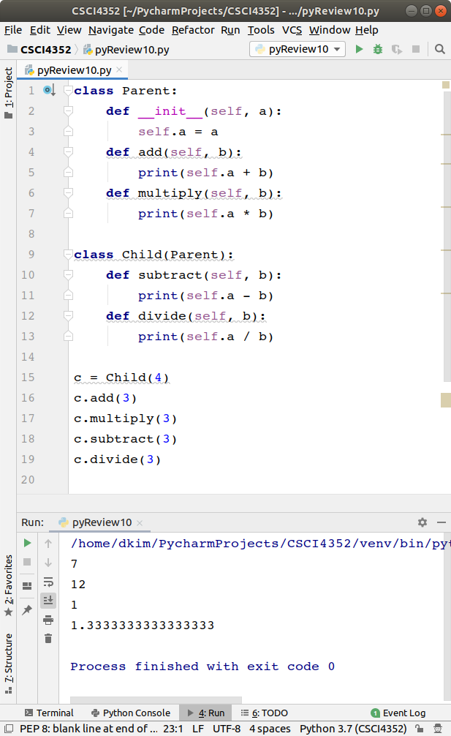
Class

Slide 11
Lab 2 - 1
Run the example codes and capture screens with outputs.
Submit python files (.py or .ipynb) and captured images of outputs and code in blackboard.

